Slide 1
Web Scraping for Financial Data
By: Michigan FinTech Technical Workshop Team

Slide 2
https://tinyurl.com/y76w986n

Slide 3
Prerequisites for the Workshop
Text Editor
Terminal
Python 3
Atom
Sublime
Xcode
Should already be installed in a Mac OS X or Windows
Instructions here
Install here

Slide 4
Introduction to Web Scraping
Walk through Code
Save Data to JSON
Step 1
Step 2
Step 3
Step 4
Step 5
URL Construction and Explanation
Download and Parse HTML

Slide 5
Financial Terms
Bid - Highest price a buyer is willing to pay for the good
Market Cap - Market Value of a company’s outstanding shares (Stock Price * #Shares)
Beta - A measure of the stock’s volatility with respect to the market
P/E Ratio - A ratio for valuing a company that measures its Stock price relative to its earnings per-share (Stock Price / EPS)
EPS: Earnings Per Share. Net Income / Shares Outstanding
Dir. of Engineering
Europe Lead

Slide 6
What is Web Scraping?
A way to fetch and extract data from a website, usually done via a bot or a web crawler but we’ll be doing it manually for this tutorial.
Useful for gathering and storing large amounts of information to be analyzed or processed later.
Has many uses, from gathering email addresses to collecting mass amounts of data for research to illegally stealing other website’s content.

Slide 7
Coding Fundamentals

Slide 8
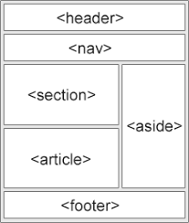
Introduction to HTML
HTML - “Hypertext Markup Language”
Used to build websites, which each tag representing a different part of the site.
Web scraping packages can sort and organize data based on HTML tags, making it easy to use.
An Example
Go to Yahoo Finance > pick a stock & navigate to stock page . > *right click* inspect element > Elements
Dir. of Engineering
Europe Lead

Slide 9
Introduction to JSON
JSON - “Javascript Object Notation”
Format for storing and structuring data that’s easy for both humans and machines to understand and read
Access specific values by indexing into the JSON hierarchy
Web Scraping will often return a JSON file of all the readable info on a webpage
Dir. of Engineering
Europe Lead

Slide 10
Introduction to APIs
API - “Application Programming Interface” → it is a set of routines, protocols, and tools for building software applications. It helps specify how the software components should interact
Quandl - Financial Data API from which we can get millions of financial and economic datasets. It is a single interface and has all the data we need, and can get as complex as we want it to be.
Learn More about the API’s features
Dir. of Engineering
Europe Lead

Slide 11
Implementation

Slide 12
Walking Through the Code
Web Scraping
API calls
Email
Learn how to use endpoints and JSON to extract useful information.
Learn how to access pre existing data with calls to a financial API.
Bonus: Add email access & capabilities via your python script

Slide 13
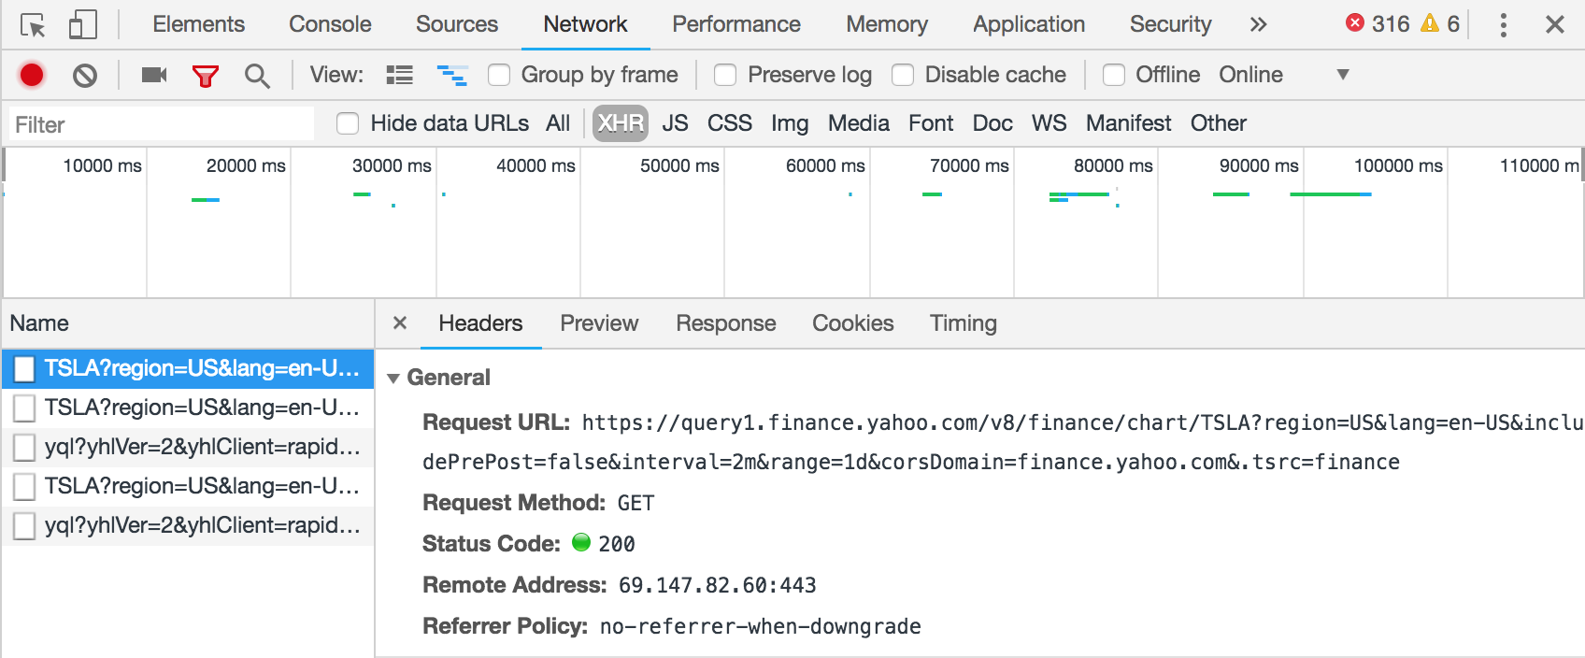
Finding the Endpoint
Go to Yahoo Finance > pick a stock & navigate to stock page > *right click* inspect element > Network > XHR
These are the URLs we can use to web scrape! For now, please use the one provided

Slide 14
Step1: Some Important Commands
to make a request: requests.get(<URL HERE>, verify=False)
To get text from HTML divs: html.fromstring(<response object>.text)
Load a response object into JSON: json.loads(<response object>.text)
Use print (json.dumps(<JSON obj>, indent=4, sort_keys=True)) to see a more organized JSON hierarchy

Slide 15
JSON example

Slide 16
Step 2: Important Commands
Add to dictionary : <dictionary_obj>.update({<key1>:<value1>,<key2>:<value2>,<key3>:<value3>})
Handle errors:
Try: <block>
Except: <throw error>

Slide 17
Step 3: API + Datatable Important Commands
Get the first entry: data.head(1)
Make it indexable: <data_obj>.reset_index()
Extract out data and closing price: index into data object similar to json!
Convert data to human readable format: (ex Jan 13th 2018 vs 01-13-2018) :"{:%B %d, %Y}".format(<date string>)
Add to json object: <JSON Obj>[“keyname”] = value

Slide 18
Step 4: Argument Parsing
To add an argument : argparser.add_argument(<argument name’,help = ' <any helpful instructions>)
To get args from command line : args = argparser.parse_args()
To get values or args: args.<argument name>

Slide 19
Step 5: Email
Enable less secure apps on gmail : https://myaccount.google.com/lesssecureapps?pli=1
To send email via server
To start server: smtplib.SMTP('smtp.gmail.com', 587)
To login to server: server.login(“<your email address>”, "email PASSWORD")
To start the server: <server obj>.starttls()
To send mail : <server obj>sendmail(“<from email>”, “<toaddr>”, text)

Slide 20
Done!
Next Steps

Slide 21
Next Steps & Ideas
Use python’s graphing and visualization tools to keep track of key metrics
Scrape twitter to see if people are talking about your company
Use python’s statistical analysis tools to find correlated stocks
Build an automated web scraper that updates data hourly (don’t get black listed!)

Slide 22
Safety and Legal Precautions
Illegal to web scrape a website that isn’t yours, unless you have received permission to do so.
Doing so can constitute the following charges: Violation of the Computer Fraud and Abuse Act, Violation of Digital Millennium Copyright Act, Breach of Contract, Trespass, and Misappropriation
While financial data is public information, the organization/arrangement of the data in a database (like Yahoo Finance or Google Finance) can be copyrighted
So make sure to stay within your legal bounds!
Dir. of Engineering
Europe Lead

Slide 23
THANK YOU!

